Slide 1
Real-Time Conversational AI Bot in Bengali Language
Using Deep Learning Techniques with Pytorch
Name: MD Rashad Tanjim
ID: 1620952042
Subject: CSE465
Faculty: AZK
Section: 1

Slide 2
What is AI Bot?
A Conversational AI-Bot is an intelligent piece of software that is capable of communicating and performing actions similar to a human.
AI-Bot are used a lot in customer interaction, marketing on social network sites and instantly messaging the client.
There are two basic types of AI-Bot models based on how they are built; Retrieval based and Generative based models.

Slide 3
Preparations
Build a AI-Bot using deep learning techniques.
The AI-Bot will be trained on the dataset which contains categories (intents), pattern and responses.
Planning to use a special recurrent neural network (LSTM) to classify which category the user’s message belongs to and then we will give a random response from the list of responses.
This will be a retrieval based AI-Bot using NLTK, Keras, Python, etc.

Slide 4
The Dataset
The dataset I will be using is in JSON format. This is a JSON file that will contains the patterns I need to find and the responses I want to return to the user via a GUI or website.
Create my own datasets by using web scraping tool to collect Bengali conversational chat from ecommerce sites, blogs etc.
Use QA questions form Kaggle.com datasets

Slide 5
Steps
Here are the main 5 steps to create a AI-Bot in Python from scratch:
Import and load the data file
Preprocess data
Create training and testing data
Build the model
Predict the response

Slide 6
Working Flow
ML Model
Deep learning tools will be used
Trained Model
AI-Bot
User
Bot will tell the answers or continue asking users for requirements
User ask or comments any questions

Slide 7
Tools
Jupyter Notebook
Google Co-laboratory
Beautiful Soap Web scrapper script
Python Made GUI, website
LSTM, Keras
Sequence2Sequence, CNN, RRN
PyTorch

Slide 8
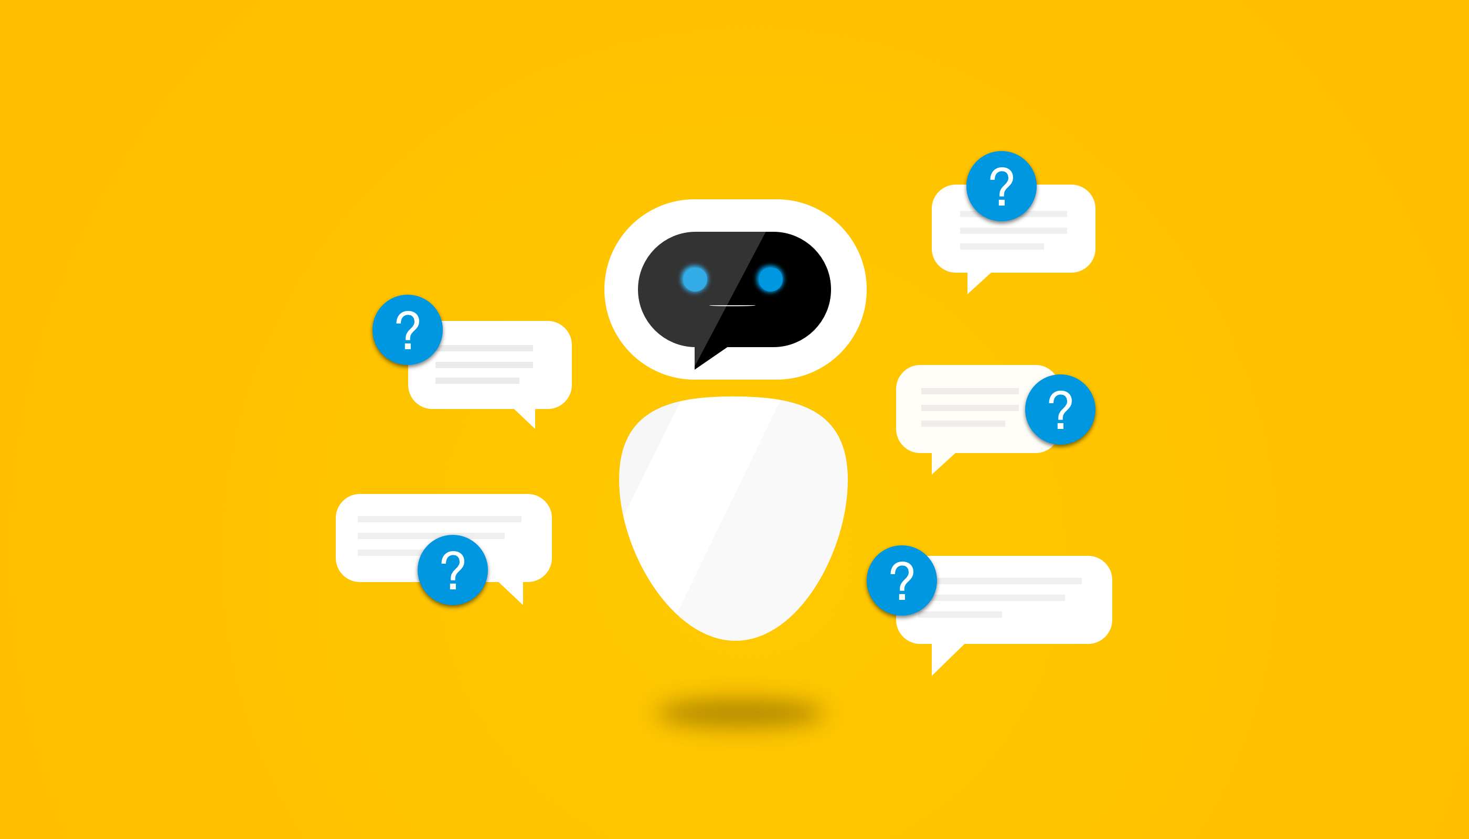
Usage
AI-Bot In Bengali Language
Improve customer service
Streamline the shopping process
Personalize communication
Improve a response rate
Automate repetitive tasks

Slide 9
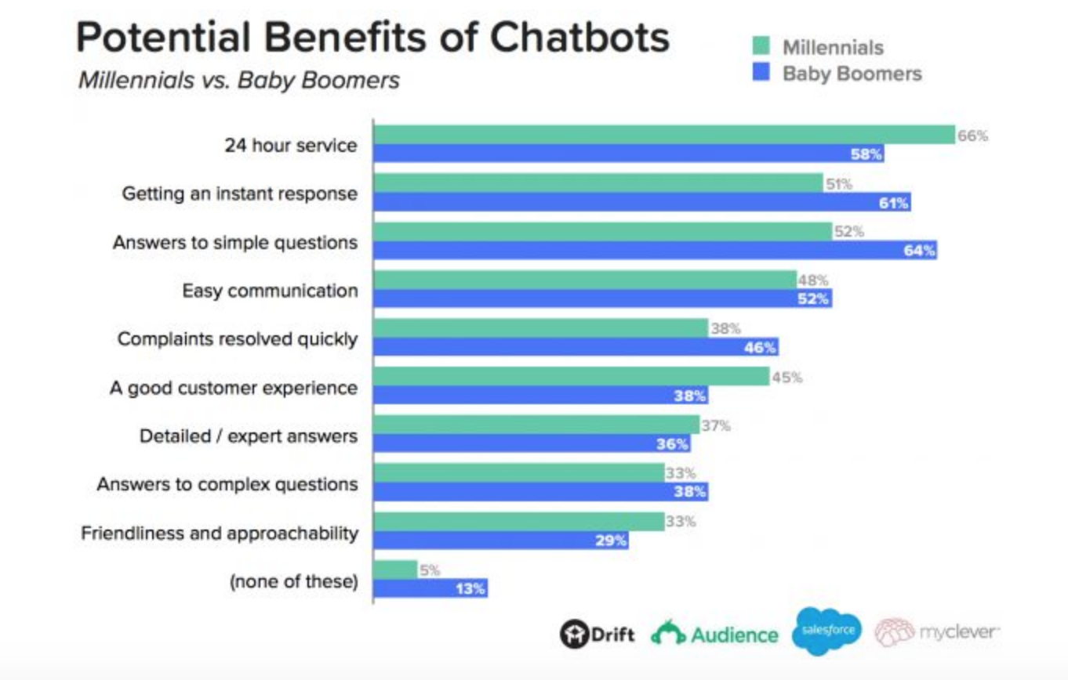
IN DEPTH
Human VS AI-Bots
Humans are good at talking and listening. They are one of the first things we learn and it is hypothesized that the sophistication of our language which allows us to coordinate using imaginary entities sets us apart from other animals. Therefore it is no surprise that people are excited about AI-Bots as they offer a language interface to the digital world.

Slide 10
Previous Works
Personalizing Dialogue Agents: I have a dog, do you have pets too?
Dialogue Learning with Human Teaching and Feedback in End-to-End Trainable Task-Oriented Dialogue Systems
Sounding Board: A User-Centric and Content-Driven Social Chatbot
Training Millions of Personalized Dialogue Agents
MultiWOZ – A Large-Scale Multi-Domain Wizard-of-Oz Dataset for Task-Oriented Dialogue Modelling
Semantic Parsing for Task Oriented Dialog using Hierarchical Representations
Towards Universal Dialogue State Tracking
Unsupervised Transfer Learning for Spoken Language Understanding in Intelligent Agents
Few-Shot Generalization Across Dialogue Tasks
Learning from Dialogue after Deployment: Feed Yourself, Chatbot!

Slide 11
Pytorch for AI-Bot
PyTorch’s RNN modules (RNN, LSTM, GRU) can be used like any other non recurrent layers by simply passing them the entire input sequence (or batch of sequences).
I will use the GRU layer like this in the ”encoder”. The reality is that under the hood, there is an iterative process looping over each time step calculating hidden states.
Alternatively, It can run these modules one time step at a time. In this case, I need to do manually loop over the sequences during the training process like we must do for the ``decoder`` model.
As long as I maintain the correct conceptual model of these modules, implementing sequential models can be very straightforward.

Slide 12
Define Evaluation
After training a model, I want to be able to talk to the bot by myself. First, I must define how I want the model to decode the encoded input.
Greedy decoding

Slide 13
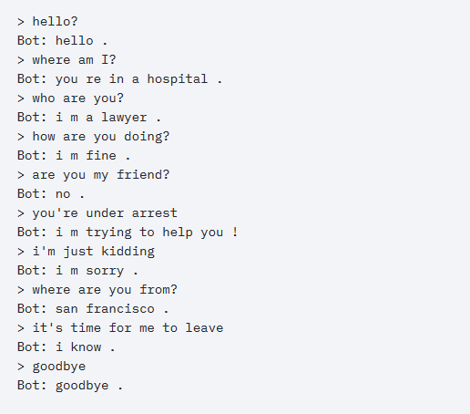
English Conversational AI-Bot Example

Slide 14
Focus Points
I will be implementing with the same way but using Bengali language.
Another unique features I want to implement is that it will also work on Bangla language but writing form of English words such as :
> Kamon acho?
Bot: Bhalo achi. Tumi?

Slide 15
THANKS
Have any questions?
Name: Md Rashad Tanjim
ID: 1620952042
Email: rashad.tanjim@northsouth.com

Slide 16
References
Yuan-Kuei Wu’s pytorch-chatbot implementation:
https://github.com/ywk991112/pytorch-chatbot
2) Sean Robertson’s practical-pytorch seq2seq-translation example: https://github.com/spro/practical-pytorch/tree/master/seq2seq-translation
3) FloydHub’s Cornell Movie Corpus preprocessing code: https://github.com/floydhub/textutil-preprocess-cornell-movie-corpus
4) Doly: Bengali Chatbot for Bengali Education
5) https://pytorch.org/tutorials/beginner/chatbot_tutorial.html
6) https://www.cs.cornell.edu/~cristian/Cornell_Movie-Dialogs_Corpus.html

